Slide 1
Understanding XYZ Airlines’ Customers
Aakriti Aneja, Hao Cheng, Shubham Garg, Jichen Liu, Maria Moy, Congyi Zhang
11.1.2022

Slide 2



Who are our customers?
XYZ Airlines has data about ticket purchases and their customers
Stronger customer relationship and more targeted marketing are benefits of knowing our customers
How much do they spend?
Do they fly Coach or First Class?
XYZ Customers
Do they have Ufly Membership?
Where and how often do they fly?
Segment customers to understand behavior and build positive relationships

Slide 3




Understanding the Data
Analyze flight data and member status
Five Customer Clusters
Understand how the five segments of customers differ
Membership Status
Analyze the membership program at XYZ
Recommendations
Increasing membership and website bookings

Slide 4
Understanding the Data
Analyze flight data and member status
Five Customer Clusters
Understand how the five segments of customers differ
Membership Status
Analyze the membership program at XYZ
Recommendations
Increasing membership and website bookings

Slide 5

Understanding the data
~3.5 years of ticket purchase data
June 2011
Jan 2015
3.4M
~1.5M
~14%
~80%
17.5%
Ticket purchases in 3.5 years
Distinct customers
Repeat
customers
Tickets purchased by Ufly Members
Customers are Ufly Members

Slide 6
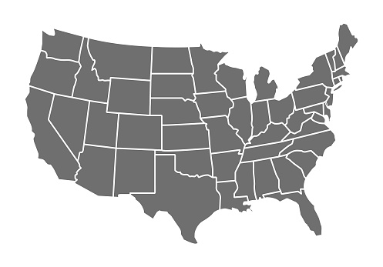


Most Popular Destinations
Understanding the Destinations
Most popular destinations for XYZ Customers to fly from and to
Airports Served
73
Most Expensive place to fly
On Average
MSP
St. Maarten
84%
JFK
8%
$732
LAS
SFO
10%
7%
LAX
7%
Average Days Booked Before the Flight
MCO
8%
46
The average proportion of customers flying from or to that destination

Slide 7
Understanding the Data
Analyze flight data and member status
Five Customer Clusters
Understand how the five segments of customers differ
Membership Status
Analyze the membership program at XYZ
Recommendations
Increasing membership and website bookings

Slide 8






Customers divided into Five Clusters
We can distinctly divide customers into 5 Clusters
1
2
3
4
5
Frequent 1st-Class Flyers (F1CF) | One-Time Low Spender (OTLS) | Website Bookers | Outside Bookers | Upgraders
Utilized the exploratory clustering algorithm of k-Means to cluster customers into natural groups
k-Means algorithm was chosen for its simplicity and power to work on complex datasets

Slide 9
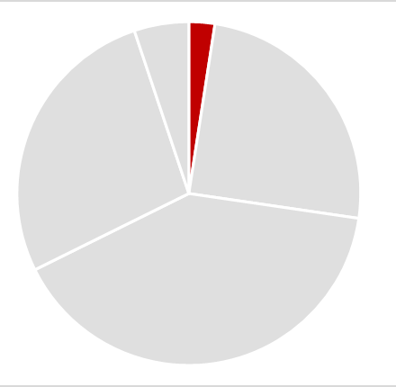
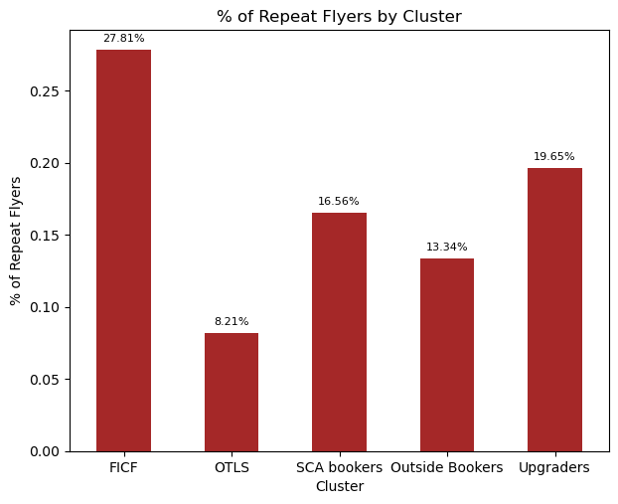
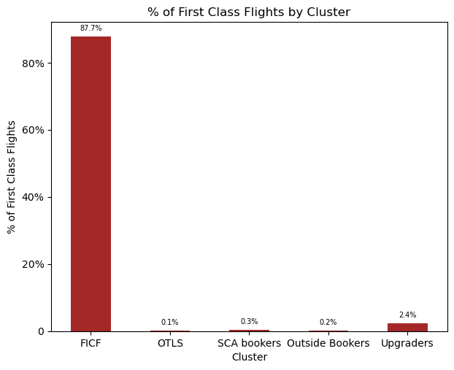
1. Frequent 1st- Class Flyers (F1CF)
Flying Behavior
27.8% customers in this cluster book repeatedly (more than once) with XYZ
87.7% flights taken are first class flights
Cluster Size
37k
Average Amount Spent/Flight
Over $200 higher than rest of clusters
$622
Membership Proportion
Standard Members: 97.3%
Elite Members: 2.7%
38%

Slide 10
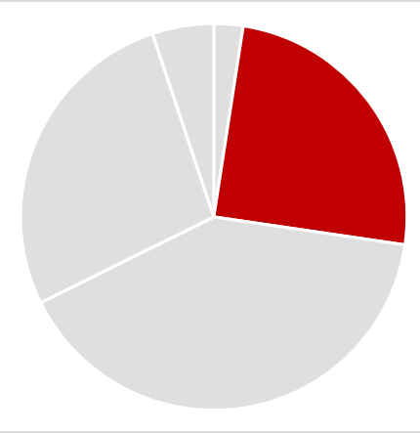
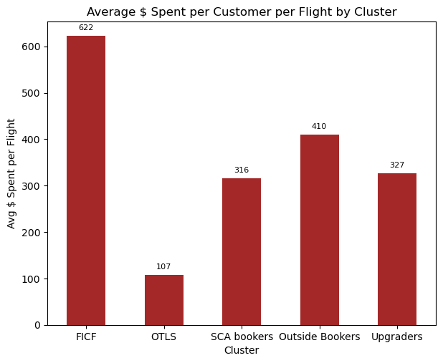
2. One Time Low Spenders (OTLS)
Flying Behavior
Only 8.2% customers in this cluster book repeatedly (more than once) with XYZ
The average amount spent per flight is $107, lowest among all clusters
Cluster Size
380k
Average number of flights per customer
Lowest among all clusters
1.87
Membership Proportion
Lowest among all clusters
7%

Slide 11
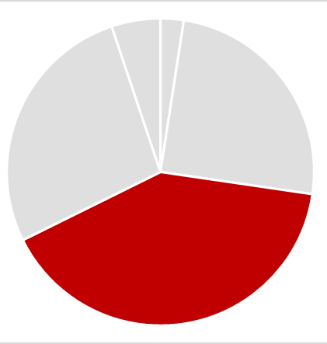
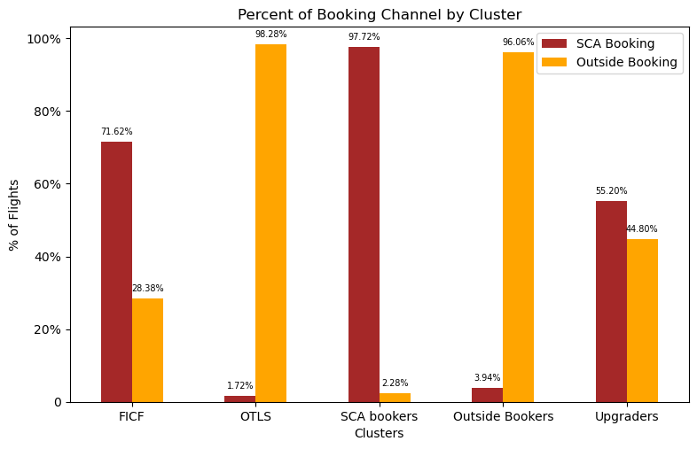
3. Website Bookers
Channel of Booking
Customers in this cluster book exclusively on the two XYZ websites – XYZ Website and XYZ Vacation (~99%)
Cluster Size
617k
Average Amount Spent/ Flight
$316
Flying Behavior
customers in this cluster fly repeatedly (more than once) with XYZ
16.6%

Slide 12
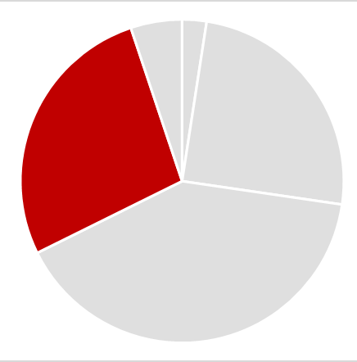
4. Outside Bookers
Channel of Booking
Customers in this cluster book exclusively through non-XYZ Websites
Cluster Size
415k
Membership Proportion
Second to lowest among all clusters
11%
Flying Behavior
Time of the year these customers fly most
Q3

Slide 13
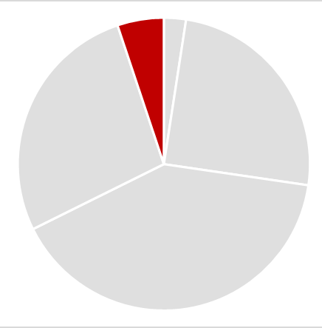
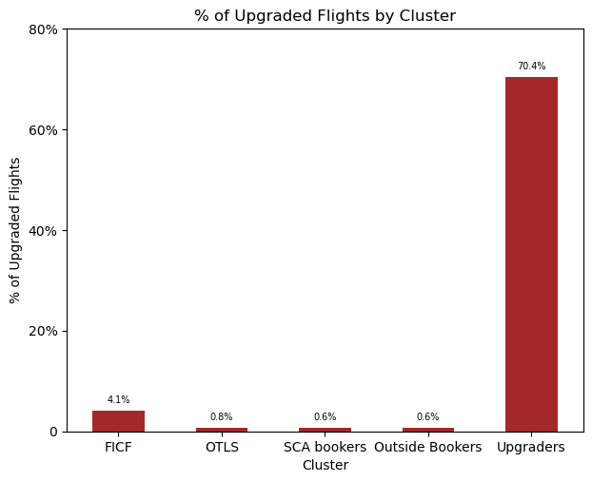
5. Upgraders
Percent of Upgrades Availed
Customers in this cluster avail maximum upgrades
Cluster Size
Cluster Size
78k
78k
Average Amount Spent/ Flight
$316
Flying Behavior
Customers flying repeatedly (more than once) with XYZ
First class flights purchased
19.6%
3.5%

Slide 14
Cluster Summary
 | Frequent 1st-Class Flyers (F1CF) | One-Time Low Spenders (OTLS) | Website Bookers | Outside Bookers | Upgraders
Number of Customers | 37k | 380k | 617k | 415k | 79k
% of Current Ufly Members | 38% | 7% | 25% | 11% | 31%
Average amount spent on a flight | $622 | $107 | $316 | $410 | $327
Average flights taken per customer | 2.47 | 1.87 | 2.19 | 2.48 | 2.57
% of flights booked on Website | 70% | 1% | 99% | 2% | 51%
% of Repeat Flyers | 27.8% | 8.2% | 16.6% | 13.3% | 19.6%
% of First-Class flights purchased | 87.7% | 0.1% | 0.3% | 0.2% | 2.4%

Slide 15
Understanding the Data
Analyze flight data and member status
Five Customer Clusters
Understand how the five segments of customers differ
Membership Status
Analyze the membership program at XYZ
Recommendations
Increasing membership and website bookings

Slide 16
Membership Statistics
Non - Members
Standard Members
Elite
Members
Average number of flights
2.08
2.54
11.08
Percent of repeat flyers
10%
24%
63%
Average Bookings website
41%
73%
72%
Average spent per flight
$307
$337
$459

Slide 17
What does it take to be a member?
XYZ Customer Lifecycle
2nd flight
Member occurs around the second flight
8th flight
11th flight
Elite member
occurs around the eleventh flight
1st flight
Membership is attained through earning points by spending on XYZ Airlines
In terms of flight bookings, on average a customer attains Elite status when they take 11 flights
On average, elite members spend $170 more on a flight
High number of flights taken on XYZ support that Elite members are loyal to XYZ
High spend and high number of flights make Elite customers most profitable to XYZ
Devising strategy to increase elite membership can increase profits

Slide 18
Understanding the Data
Analyze flight data and member status
Five Customer Clusters
Understand how the five segments of customers differ
Membership Status
Analyze the membership program at XYZ
Recommendations
Increasing membership and website bookings

Slide 19



1. Target Potential Elite Members in F1CF
Average member customer in F1CF
 | Standard Member | Elite Member
Amount Spend per flight | $635 | $675
Number of flights taken | 3 | 10
Lifetime Amount Spent | $1980 | $6680
Difference not huge
Elite take 230% more flights
Elite spend ~$4600 more
Target non/standard members in F1CF who have taken 7-9 flights to convert them to elite status
Why target these customers?
High Spend Ability
Customers in this cluster spend higher
Potential for Elite Status
Only 2.7% of members have Elite Status
Specific Targeting
Customers to target are low, expected returns are high
High Affinity to Elite Status
Frequent 1st Class Flyers - care about benefits of elite service

Slide 20
2. Drive Outside Booking Members to Websites*
*
~99%
$460
11%
36%
Bookings from outside channels
Avg Spend
(2nd highest)
Membership Proportion
Members who are repeat flyers
Target members of this cluster with incentives when booking on website
Selectively targeting only members for their repeat flying behavior to build loyalty
Drive these members to XYZ websites by incentivizing with higher reward points when bookings made on XYZ websites
Increased traffic on websites and a nudge to book more flights from points gained

Slide 21
Appendix

Slide 22




Data Cleaning
Age
43k records with missing age
5k records have Age < 0 and Age > 100
Drop missing and outlier records
Gender
43k records with missing gender
Distinct values – M, F, U, NA
Drop missing records
Postal Code
Represents where the booking was made from
80% missing values
Drop column due to high missing %
How to define a customer?
Encrypted Name | Gender Code | Birth Date ID
1.5M
Use the above columns to identify unique XYZ customers
Customers purchased tickets with XYZ Airlines

